Slide 1
Chatbots Development with Machine Learning
Machine Learning Chatbots
Hands on: Rule Based Chatbot with Machine Learning and Python
Shahzaib Hamid
AI Sciences Instructor

Slide 2
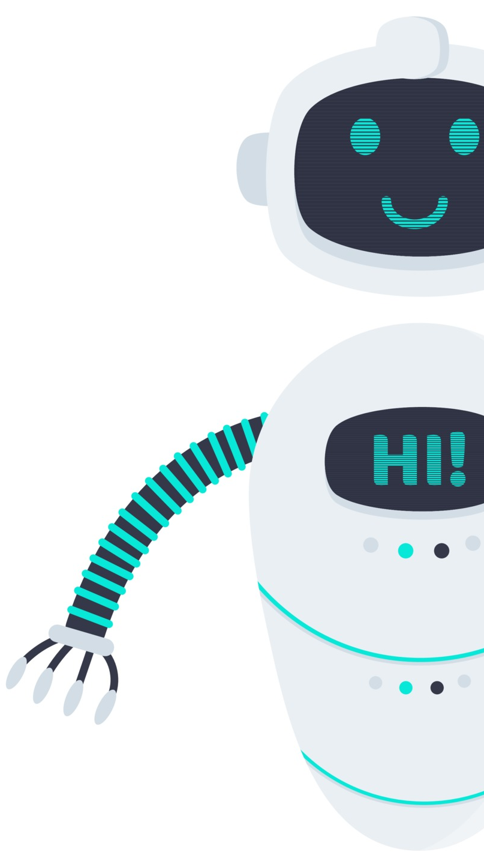
Conversational Chatbot Development with Machine Learning
Develop a Machine Learning based Conversational Chatbot with NLTK
Packages Installation
Creating Corpus with Python
Text Preprocessing and Helper Function Deployment
Generating Responses
Implementation of term-frequency times inverse document-frequency
Training and Testing of Rule Based Chatbot

